Slide 1

Python: From Foundational Logic to Machine Learning
Presenters: Sanvi, Shivansh and Shayan
Batch: AIML Training (from CSE)
Date: 27/07/2026

Slide 2
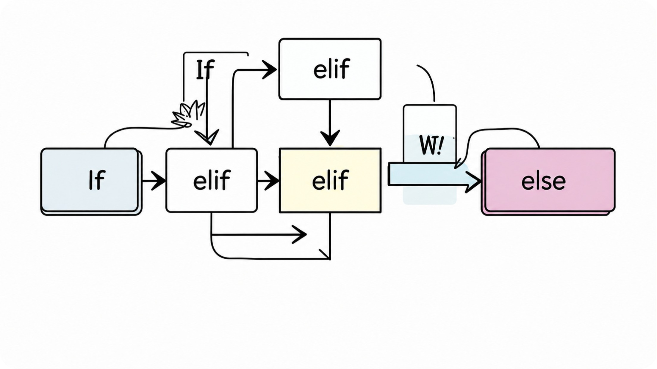
Flow Control: If, Loops, and Flow Modifiers
Conditional Branching
if / elif / else — guard logic, nested vs flat style
Loops
• for: iterate sequences.
• while: entry level loops.
• do-while: exit level loops.
Modifiers
break (exit), continue (next iteration)

Slide 3
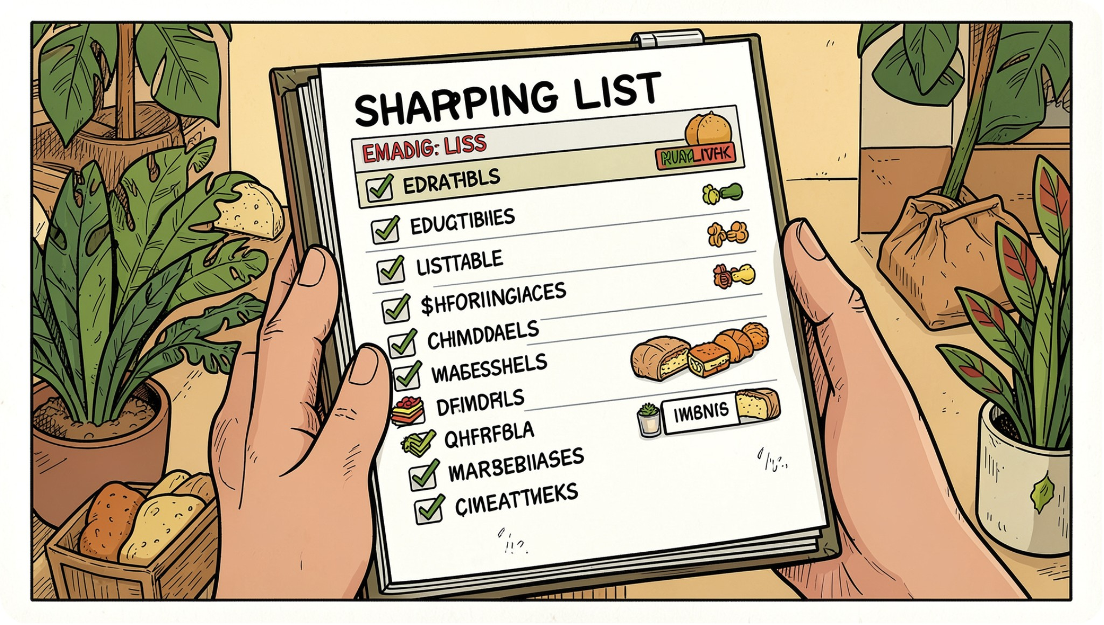




Fundamentals Of Python
List
Tuple
Mutable, ordered, undexable
Immutable, ordered — use for fixed records
Set
Dict
Unordered, unique — fast membership checks
Key → value mapping — fast lookup by key

Slide 4

System Interactions: File Handling & Modular Code(File I/O)
01
02
File Modes
File handling details
"r" opens a file for read only, "w" writes and overwrites existing content, "a" appends new content to the end of a file, and "x"
creates a new file and fails if it already exists.
File Operations:
open(), close(), read(), readline(), readlines(), and write() support the core workflow for working with files. Use open() to access a file, read() to load the full contents, readline() and readlines() to process line by line, write() to write data, and close() to release resources when not using a context manager.

Slide 5
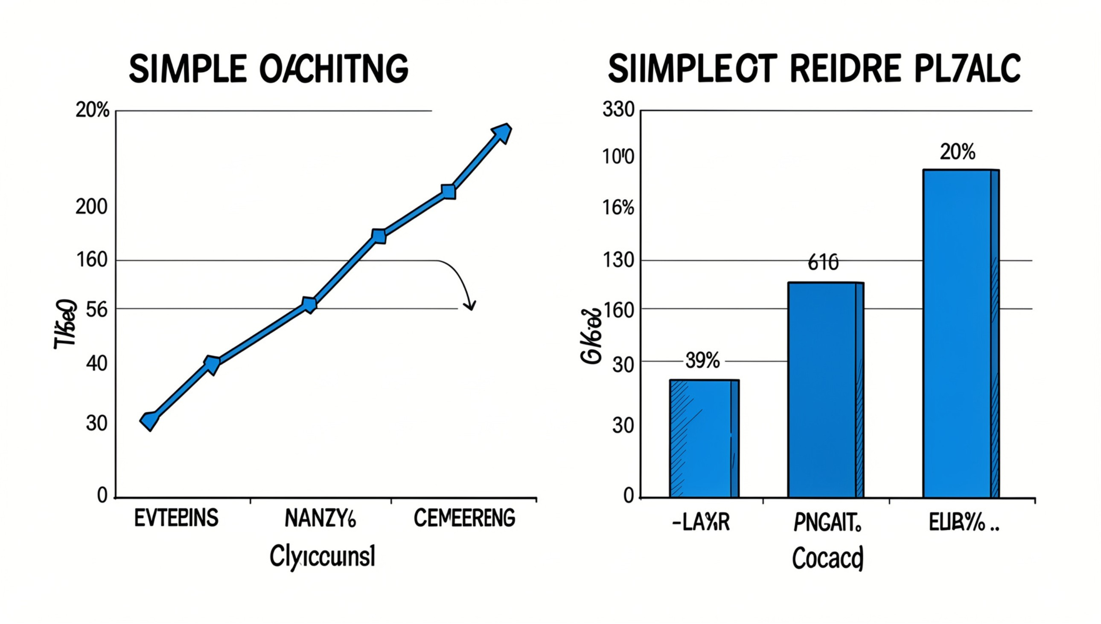
Numerical Analysis & Visualization
NumPy
ndarray, vectorized ops, linear algebra, performance
Pandas
Series/DataFrame • cleaning, groupby, merge, pivot
Matplotlib
plots, customization, exploratory visuals
Use visual inspection + summary stats to find trends & outliers

Slide 6

NumPy: The Power of Numerical Arrays
NumPy (Numerical Python) is a foundational library for scientific computing, essential for mathematical calculations, data analysis, machine learning, and AI.
Performance
Significantly faster than Python lists for numerical operations, ideal for large datasets.
Efficiency
Uses less memory for storing numerical data, making it suitable for memory-intensive tasks.
At its core, NumPy introduces the ndarray (n-dimensional array), a powerful data structure for efficient handling of numerical data, from 1D vectors to multi-dimensional matrices.
Installation:
pip install numpy
Import:
import numpy as np
Advanced Math
Offers extensive mathematical functions (ufuncs) for complex computations like linear algebra.

Slide 7
NumPy: Essential Functions and Universal Functions (ufuncs)
NumPy provides a vast array of functions to efficiently manipulate arrays. Among these, Universal Functions (ufuncs) are pivotal for performing fast, element-wise operations on arrays, significantly enhancing computational speed and ease of use.
Element-wise Operations
UFunctions
Ufuncs apply mathematical operations like addition, subtraction, or sine to every element of an array independently, without requiring explicit loops.
Leverage C implementations under the hood, ufuncs are dramatically faster than Python's built-in operations for large datasets, making them ideal for performance-critical tasks.
import numpy as np
a = np.array([1, 2, 3])
b = np.array([10, 20, 30])
np.add(a, b) # [11 22 33]
np.multiply(a, b) # [10 40 90]
# Python loop
result = []
for x, y in zip(a, b):
result.append(x + y)
# NumPy ufunc
result = np.add(a, b)
Practical examples:
np.sqrt([1, 4, 9, 16]) → [1. 2. 3. 4.]
np.sin([0, np.pi/2, np.pi]) → [0. 1. 0.]
np.maximum([1, 5, 2], [3, 4, 1]) → [3 5 2]
Broadcasting Support
They automatically handle operations between arrays of different but compatible shapes, simplifying code and reducing memory usage.
a = np.array([[1, 2, 3],
[4, 5, 6]])
b = np.array([10, 20, 30])
np.add(a, b)
# [[11 22 33]
# [14 25 36]]
Extensive Library
NumPy offers hundreds of ufuncs for mathematical (np.add, np.sqrt), trigonometric (np.sin, np.cos), comparison (np.maximum), and bitwise operations.
Real-world uses include image processing, signal analysis, feature scaling, and fast thresholding in data pipelines.
These functions are crucial for scientific computing, enabling complex calculations with minimal code and maximum efficiency.

Slide 8
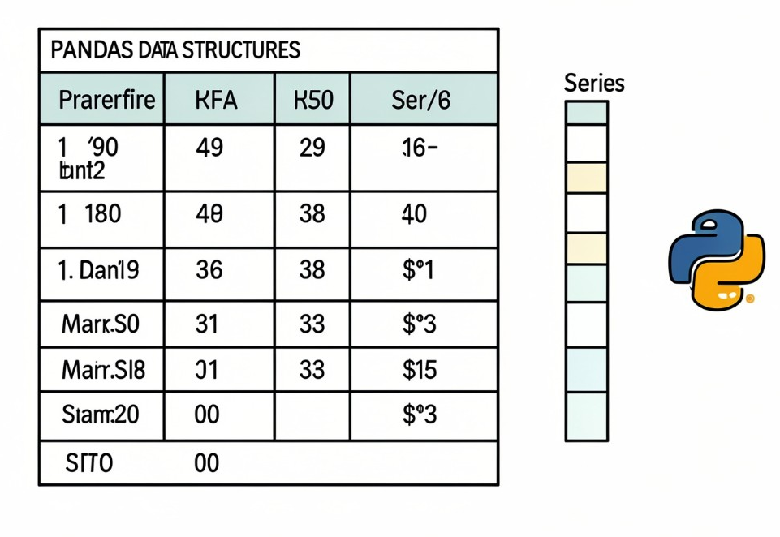
Pandas: Data Manipulation & Analysis
Pandas is a foundational library for data science in Python, providing powerful, flexible, and easy-to-use data structures for working with tabular and time-series data. It has the combining power of Excel, SQL, and Python for efficient data handling.
What is Pandas?
Series (1D Data)
DataFrame (2D Data)
Python's powerhouse for structured data, simplifying tasks that would be complex with standard Python lists or NumPy arrays.
A one-dimensional labeled array capable of holding any data type. Conceptually, it's like a single column in a spreadsheet or a SQL table.
A two-dimensional labeled data structure with columns of potentially different types, much like a spreadsheet or a SQL table.
Installing and Importing Pandas
Use pip to install Pandas, then import it with the common alias pd.
# Install Pandas
pip install pandas
# Basic import
import pandas as pd
# Check version
pd.__version__

Slide 9
Pandas: Essential Data Operations
Pandas provides a comprehensive toolkit for common data manipulation tasks, making data preparation and analysis efficient and intuitive. Let's explore some key functionalities:
Data Input/Output
Data Selection & Filtering
Easily load data from various sources like CSV, Excel, SQL databases, and JSON files into DataFrames.
Access and isolate specific subsets of data based on labels, integer location, or conditional logic.
Reading csv and excel files
Writing back to files
Selecting Data by columns or rows
Filtering Data with conditions
Data Cleaning & Sorting
Data Transformation
Handle missing values, duplicates, and ensure data consistency. Arrange data in meaningful orders.
Modify existing data or create new derived features to enrich your dataset for analysis.
Data Cleaning (e.g., handling NaNs)
Sorting Data by values or index
Add new Columns and rows
Apply functions to data
Aggregation (GroupBy)
Combining DataFrames
Perform powerful aggregation operations to summarize data based on one or more keys.
Integrate data from multiple DataFrames using various joining and concatenation methods.
GroupBy for summarization
Applying aggregate functions
Merge DataFrames (joins)
Concat DataFrames
Reshaping Data (Pivot)
Transform data between "long" and "wide" formats for different analytical needs, similar to spreadsheet pivot tables.
Pivot Tables for summarization
Stack and Unstack operations

Slide 10
Matplotlib: Data Visualization Essentials
Matplotlib is Python's cornerstone library for creating static, interactive, and animated visualizations. It transforms numerical data into insightful graphs and charts, making complex datasets easily understandable.
Getting Started:
Understand Data Quickly
# Installation
pip install matplotlib
# Import
import matplotlib.pyplot as plt
Visualize trends, patterns, and outliers at a glance.
Compare & Analyze Values
The pyplot module provides a MATLAB-like interface for plotting. It's the most commonly used part of Matplotlib.
Easily compare different data points and relationships.
Basic Plotting Cycle:
plt.plot(), plt.bar(), plt.hist( ), plt.pie( ), plt.scatter( )to create the chart.
plt.title(), plt.xlabel(), plt.ylabel() for context.
plt.show() to display the visualization.
Effective Reporting
Create professional, publication-quality figures.

Slide 11
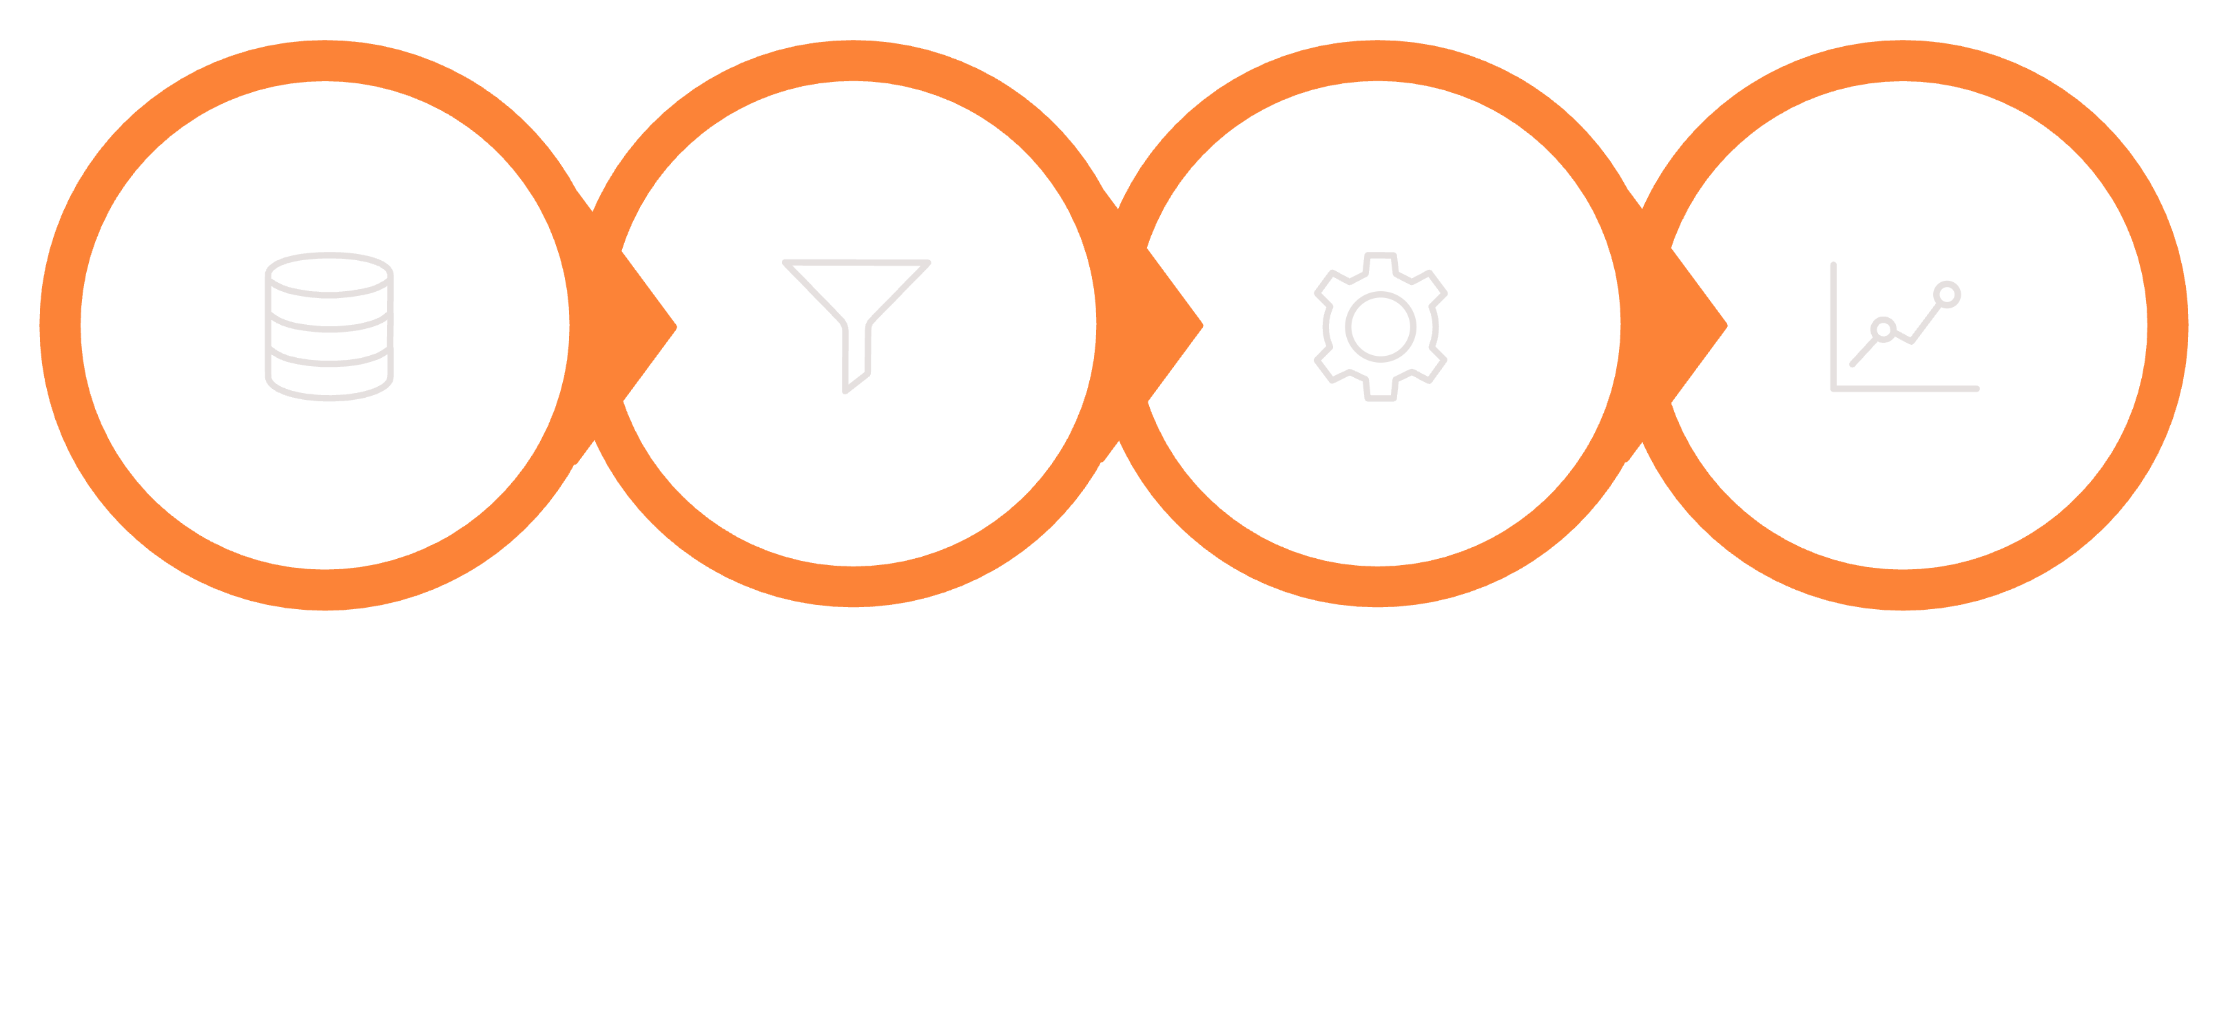
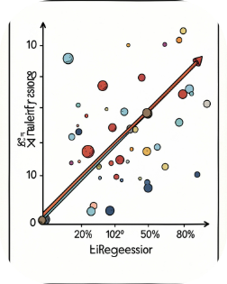

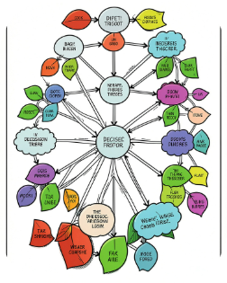
The Machine Learning Pipeline
Regression
LinearRegression — predict continuous data
LogicalRegression — predict category
KNN
K-Nearest Neighbor
K = number of nearest neighbor
Load data
Preprocess
Train model
Evaluate
Decision Tree
It is a flowchart like algorithm, which ask series of questions, based on answers it reaches the final decision.
Always split (train/test)
Scale features when needed

Slide 12

Customer Segmentation, Customer Type Prediction & Country Growth Prediction

Slide 13


10-Days AIML Training — Key Skills
Python fundamentals
Data handling
NumPy, Pandas — cleaning & transforms
list, tuple, set, dictionary
Supervised learning
Visualization
Linear, Logistic, Random Forest
Matplotlib — exploratory plots
Unsupervised learning
KMeans clustering
This project applies these concepts together on a real-world retail dataset.

Slide 14

Project Overview
Problem: Raw transaction data — no customer insight, unclear growth focus.
Dataset
Three objectives
~540,000 UK online retail transactions (Dec 2010–Dec 2011)
8 columns: InvoiceNo, StockCode, Description, Quantity
InvoiceDate, UnitPrice, CustomerID, Country
Segment customers (KMeans)
Predict customer type for new customers (Random Forest)
Predict country sales growth (Linear Regression)

Slide 15
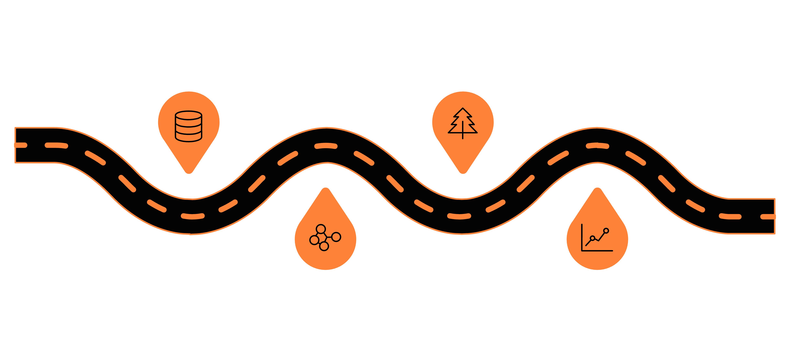
Methodology — High Level Flow
Prepare Data
Model Segments
Cleaning and compute key features
Train Random Forest on labels
Country Regression
Cluster
Elbow (k=4) then KMeans clustering
Linear models per country
Note: Manual train/test split and manual accuracy calculation used to demonstrate fundamentals (not a black-box).

Slide 16
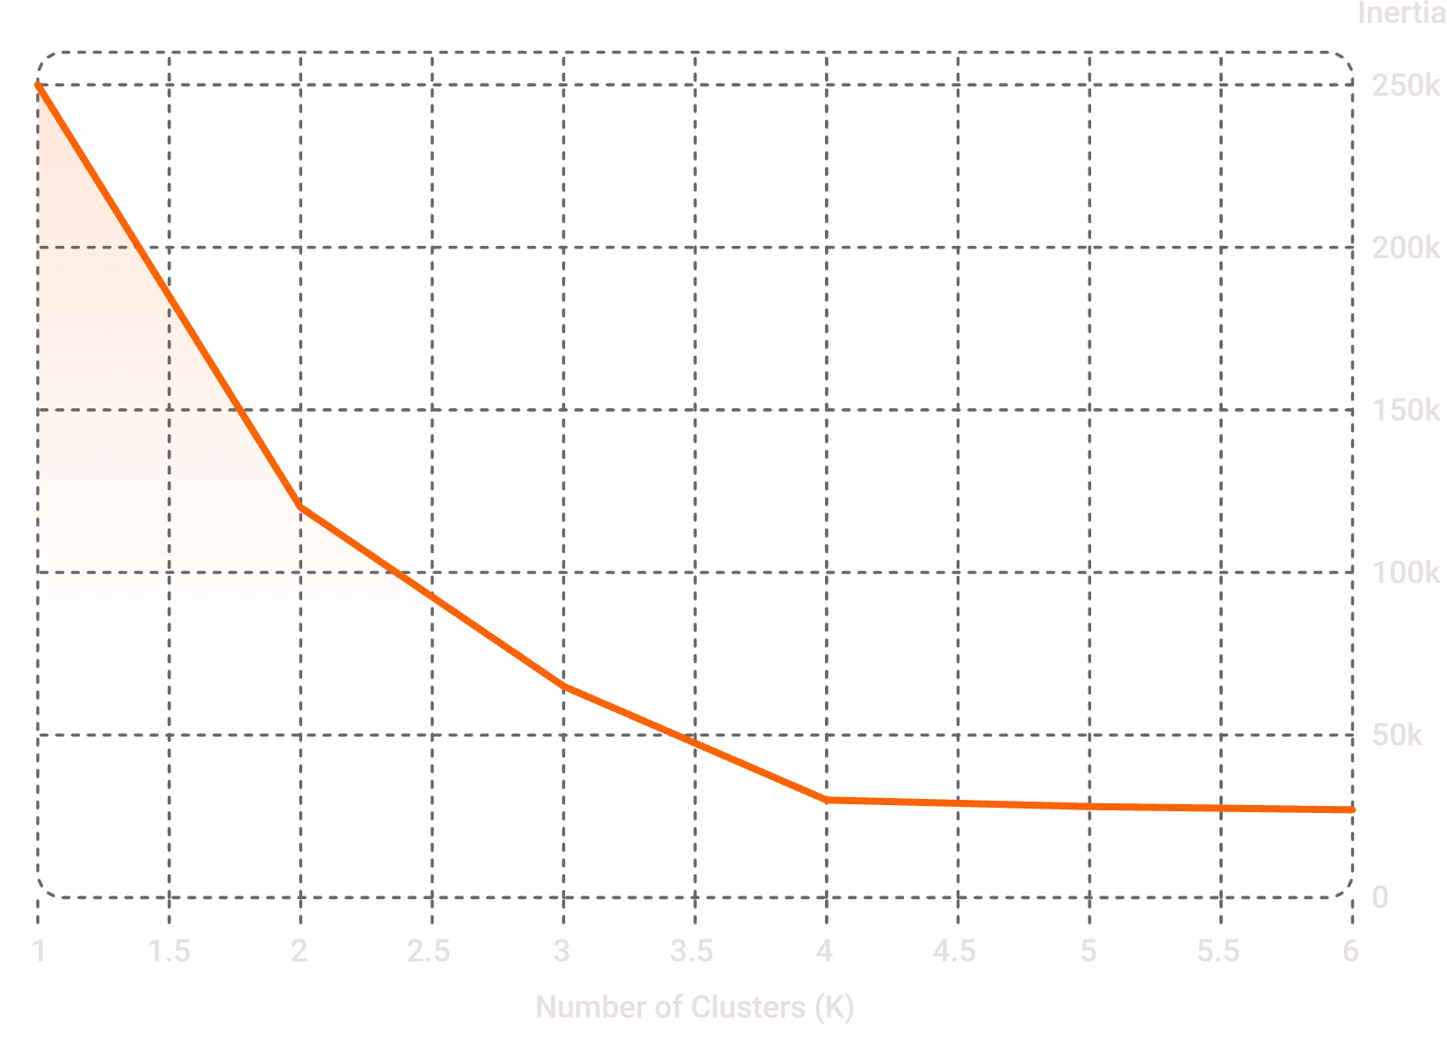
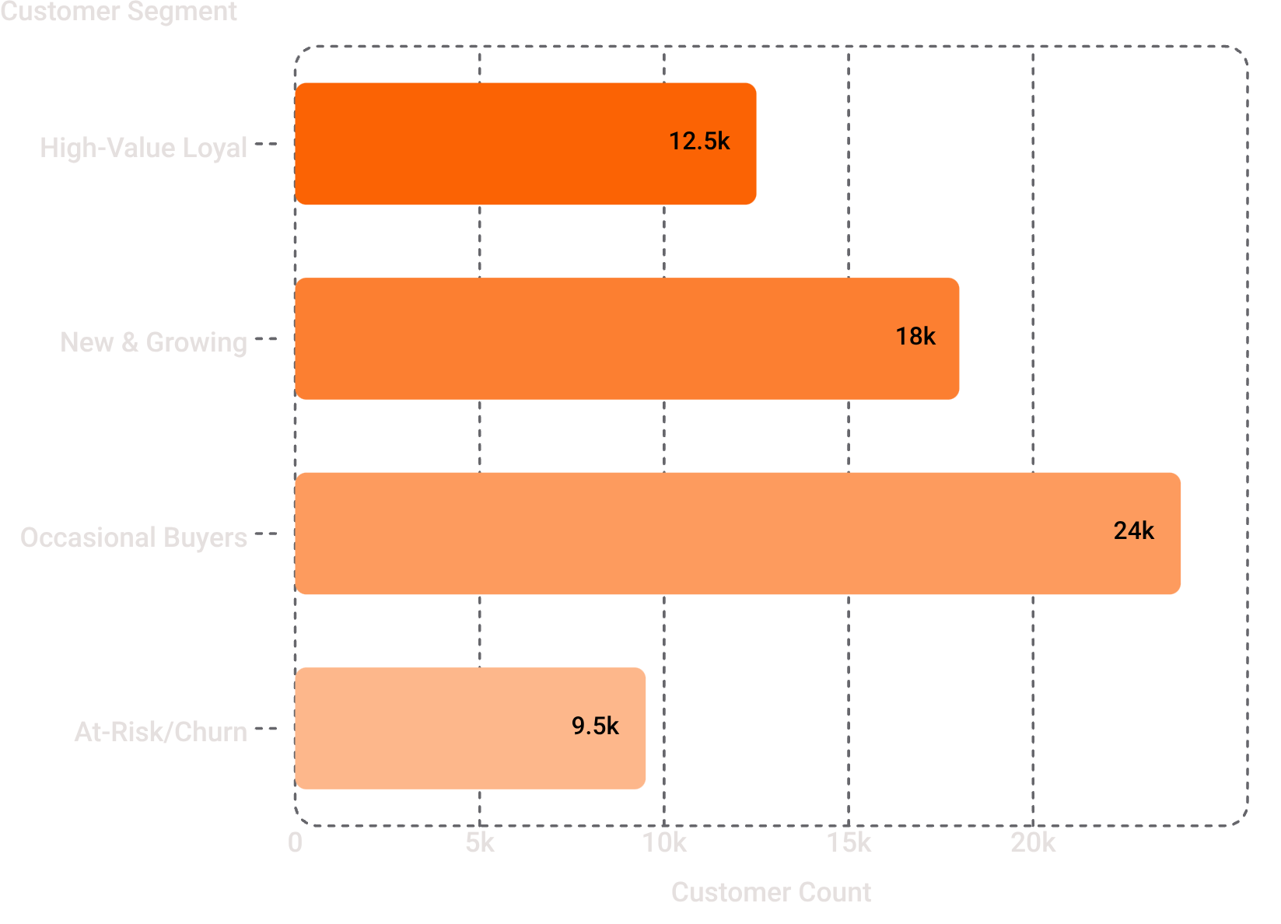
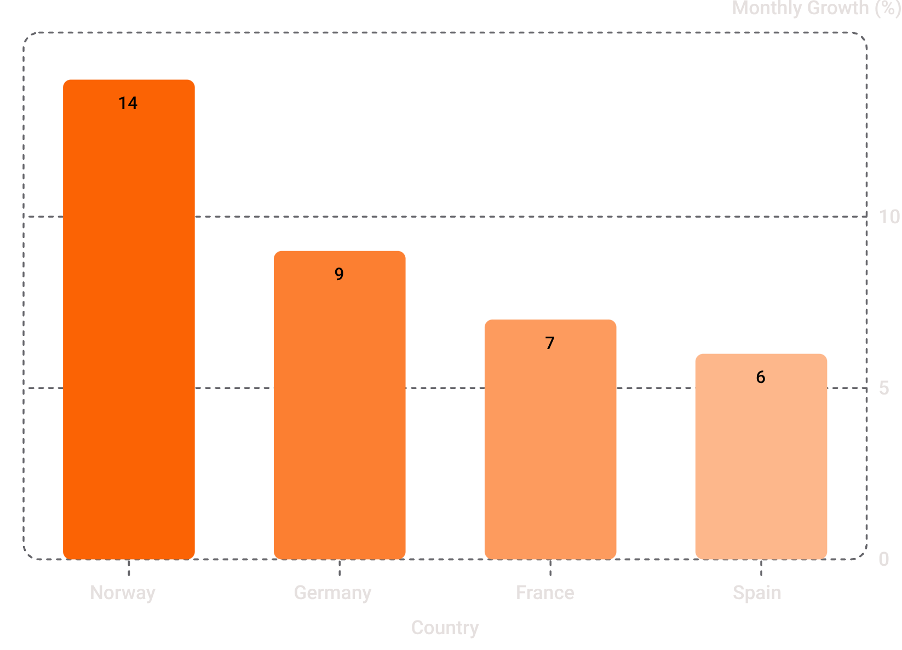
Results — Visual Highlights
Customer Segments Overview
Our analysis reveals actionable insights across customer segmentation and growth prediction.
Optimal Clusters: Elbow Method
The elbow method clearly indicates 4 optimal clusters for customer segmentation, where the decrease in inertia significantly diminishes.
A breakdown of the four customer segments by their relative sizes, informing targeted marketing strategies.
Top Country Growth Prediction
Customer Type Prediction Accuracy
98.6%
Random Forest
Test Accuracy
Our Random Forest model achieved exceptional accuracy in predicting customer segments for new customers.
Norway stands out with an estimated monthly sales growth of ~14%, highlighting key international market potential.

Slide 17

Business Impact & Next Steps
Targeted marketing
Retention priority
Instant classification
Focus on high-value churn risk segments
Campaigns matched to segment value
Predict new-customer type at signup
Expansion decisions
Prioritize countries with positive growth (e.g., Norway)
If more time: add Recency to build RFM, ingest more countries, automate model pipeline and deploy as a live dashboard. Now — I'll switch to the Jupyter notebook to show the implementation.

Slide 18

Thank You!
We appreciate your time and attention today.

